Slide 1
WHY Flux?
We believe that games are the absolute cultural works of our time.
From a fusion of art, music, technology and imagination into rich, innovative experiences, continuously redefining how we think, feel and interact with the world.
We want to bring together visionary game developers, fearless storytellers, bold designers, and curious minds.
Creating spaces for exploration, surprise, learning and inspiration, unlike anything Denmark has seen within cross-sectional festivals.
We will cement Aarhus as a vibrant hub for game culture, creativity, and innovation.
Flux is built to grow into one of Northern Europe’s most exciting gaming culture events – with Aarhus as a meeting point for thousands of players, creators, and industry leaders from across the world.
A non-profit association supporting talent and tomorrows gaming scene.
Flux is an association established by Games Denmark, Kong Orange, Arkaden and Funday among others.
We have already secured 1,5M DKK from Aarhus Municipalities in funding and we are moving into operating mode over the next weeks with Games Denmark as the driving force.

Slide 2
WHAT IS Flux?
An ambitious two-day festival in Aarhus, consisting of masterclasses, game showcases, alternative talks, performances, music, and fandom.
Tracks include:
Creator Lab ⇨ Education/Talent ⇨
Experiences ⇨
The Playground ⇨
Community ⇨
(for game developers/curious minds)
(for teachers/students)
(showcases, performances, talks)
(art, XR, experiments)
(fandom, merch)
Possible themes/mottos:
“Inter//Play”
“Crossing Signals”
“New Rules of Reality”

Slide 3
Flux PILLARS
Play as Culture
Exploring the meaning of games beyond entertainment — as art, philosophy, and shared human experience.
Walk & Talks
Philosophy
Collectives
Cross-disciplinary
Create & Learn
Empowering creators, educators, and experimenters to expand their craft. Developing talent.
Masterclasses
Workshops
Tool Labs
Show & Share
Inviting the audience into the games. The festival becomes a gallery, arcade, and playground.
Showcase
XR installations
Performances
Music
Connect & Celebrate
Creating a space for celebration of creative communities, fandom, and friendship.
D&D Live
Indie Market
Artist Alley
Cosplay

Slide 4
HOW DO WE DO THAT?
By curating a multi-day choreographed game festival, where everything becomes a part of the whole:
Showcases: We want to celebrate a curated selection of games as the intersection of art, culture and technology.
Masterclasses: We want to educate and inspire game developers and educators.
Live events & Workshops: We want to stage the unexpected, up close and personal, bridging creators, educators, and fans.
Talks: We want to inspire new perspectives on play, design, and creativity. No generic slideshows or panels - we want speakers that excite and go deep.
Fandom & Merch: We want to invite people to lean into their game interest and interact with a curated selection of creators of their favorite Danish games.
Art, Music & Performance: We want experiences not just words. Art, music and performance will be present across the entire festival.
Notes:
Live performances: theater troop suddenly fighting with rag doll physics in the Foyer. Or speed draw against the best artists in the business.
Fandom: Jimmy lyngvild sammen med 3 af Danmarks bedste cos-players og så laver de et mode-show, og så er det det. Ikke mere.
Hvis vi skal have en merch ally, kan vi så sige, max 5 artists, og så skal folk ansøge og fortælle os hvorfor det netop skal være dem, der skal med, og hvorfor deres merch butik er uundværlig og særlig.
Musik/performance: Be it live music for live gaming, a spoken word talk with a guitarist backing or something entirely third.

Slide 5
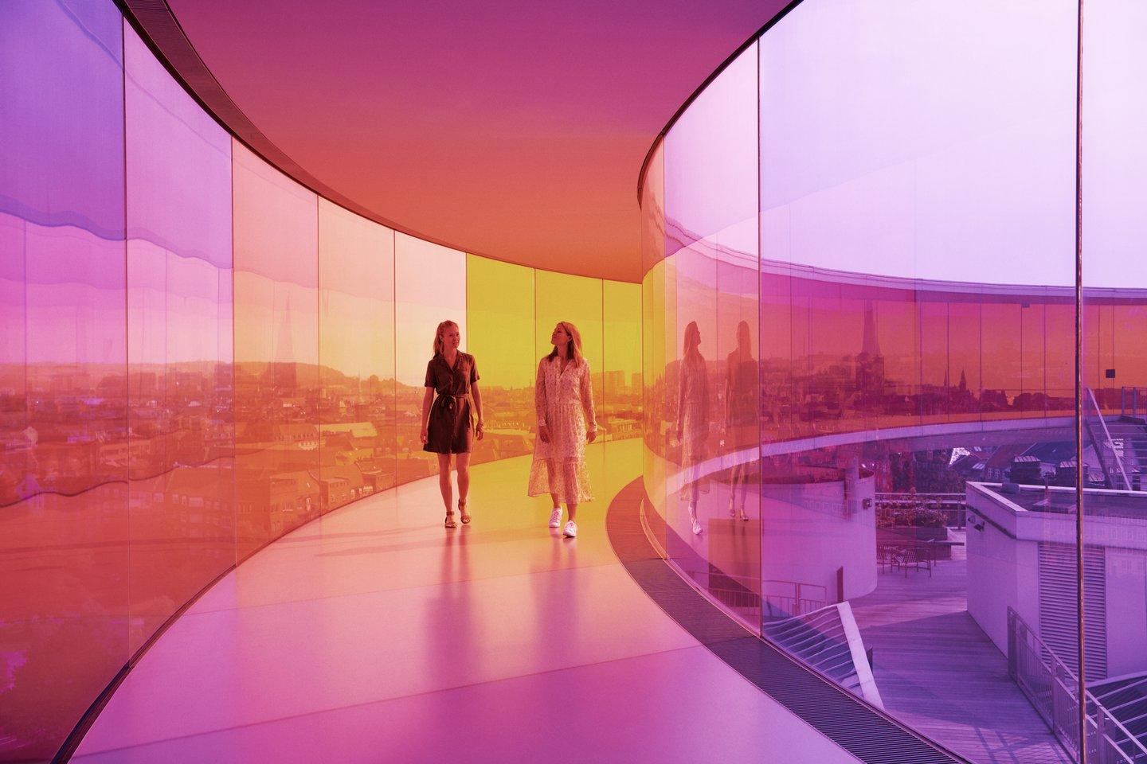
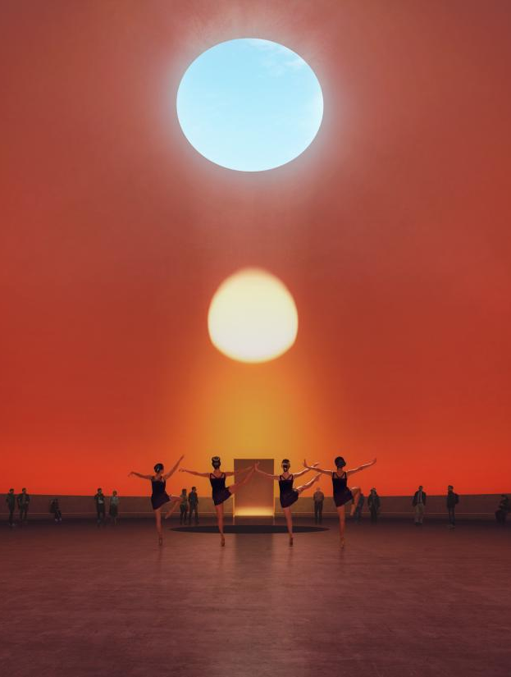
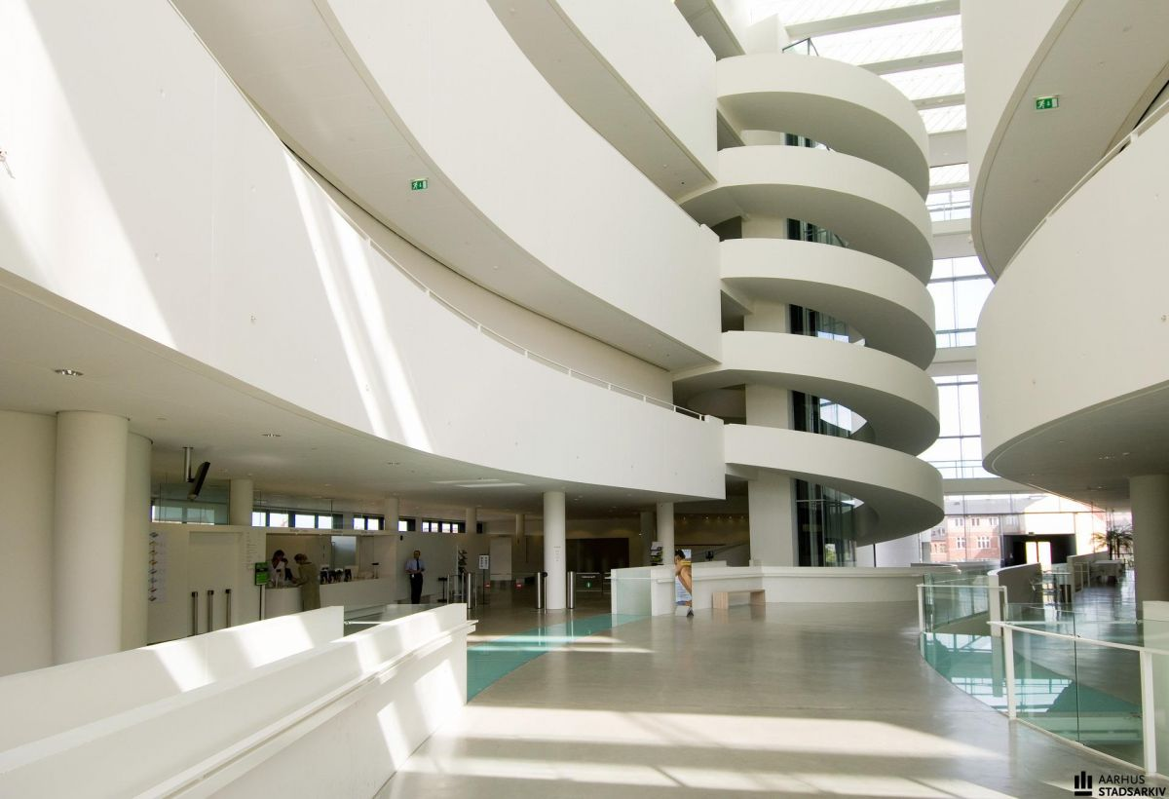
Flux AT A GLANCE
An ambitious two-day event with a curated theme each year
Date: November 20-21, 2026
8-10 talks and panel-free discussions that bring industry voices to the audience in engaging ways
5 performances blending games with music, storytelling, and art
5-6 activities for people to engage with
2-3 different “spaces” for community and art
Evening networking party to connect people in an informal setting

Slide 6
OUR VISION
Flux is built to grow into one of Northern Europe’s most exciting gaming culture events – a meeting point for thousands of players, creators, and industry leaders from across the world.
Starting in 2026 as a curated two-day experience in Aarhus, our ambition is to scale up in the coming years to attract tens of thousands of visitors, while keeping the heart of the event the same: inspiring talks, unique live experiences, and the kind of encounters that make people return year after year.
As a non-profit event, FLUX is driven by a mission to nurture new talent and help emerging creators find their place in the industry. We want to give both aspiring and established voices a stage, creating opportunities for learning, collaboration, and growth.
We believe that games are more than entertainment – they are art, culture, and a global language. Flux will be the place where that belief comes to life, year after year.
Flux aims to place games firmly within the cultural landscape of Aarhus, making the city a hub for creativity and game innovation.
We want to build a format that can stand alongside international events like EGX (London) and AMAZE. (Berlin), but with a distinctly West Danish identity.

Slide 7
AUDIENCE & GOALS
Year 1 target: 2000 attendees
Audience groups:
  Developer/Creators: learning, networking, creating, feedback and recognition
  Public/players: new immersive experiences, culture (nerdiness), inspiration
  Media: stories on thought leadership, Denmark as a game nation and as a innovation/design frontrunner
Target age group: 18–45+
Goals:
  Create a memorable, unique experience worth traveling for. Think EGX or SXSW for games, in Aarhus.
  Moving away from traditional panels and more towards new, intersectional experiences.

Slide 8
WHY AARHUS?
Aarhus is the perfect place for a festival that bridges games, art, and culture. It presents an experimental creative scene within a environment of design and technology, and invites the audience to explore both established and grassroot initiatives. From institutions like ARoS Art Museum and Godsbanen to independent studios, collectives, and universities, Aarhus thrives on collaboration across disciplines. Its legacy as European Capital of Culture in 2017 has cultivated a lasting spirit of openness, design thinking, and cultural innovation, and is therefore an ideal foundation for a festival that integrates curiosity, reflection, and play into its DNA.
Aarhus is home to several strong game studios like Funday Games, Fair Games, and Kong Orange, and provides a solid foundation for new talent from DADIU and Dania through its ecosystem structures like Game Hub and Ideas Lab. By building an alternative festival like Game Punch, we use the city’s already existing cultural dynamics to grow sustained interest in game development and the communities of practice that thrive alongside it.

Slide 9
THE TALKS AND ACTIVITIES
Flux does not want to simply be another festival with talks and panels. We’re here to explore, challenge, and surprise — to push boundaries and celebrate games in all their diverse, unexpected forms.
We’re seeking out fresh perspectives, alternative talks, and bold combinations of experiences that engage audiences in new ways. Every part of Flux will stay true to its core: a festival dedicated to game culture in all its depth and creativity.
We have identified some requirements that we would like the talks to fulfill:
Audience participation and engagement
Game show or quiz elements
As a reflection of one or more game-related mechanics or culture (PvP, speedrunning, skipping, choose your own adventure, etc.)
Pitching, roasting, critique
Combined talk + performance/music
Includes humor, satire, drama, theatre or live elements

Slide 10
REVENUE MODEL
Ticket sales (tiered): We will offer a tiered ticketing model with the possibility to buy access to Masterclasses, workshops and dev talks.
Artist Alley tickets: We will sell separate tickets to become an exhibitor in the Artist Alley.
Sponsorships and brand activations: We will offer sponsors and brands the opportunity to align their identity with one of the most exciting new gaming festivals in Northern Europe.
Grants / public arts funding: We have already secured support from Aarhus Kommune and the NIMBI Game Development Institute, and will be applying for grants from among others Den Vestdanske Filmpulje.

Slide 11
Example activities and performances
Play as Culture
Big Band Aarhus
Zirkus
Piano Concert (game music)
Miguel Sicart
Show & Share
MANND XR
Jakob Knud Steen
Mock Trial (feat. DAHL)
Ste Curran
[namethemachine]
Create
Unreal Lounge
SketchUp XR
Voxel Engine
Learn
Masterclasses
Connect & Celebrate
Book Signing (50 spil)
Game Culture Bingo
LAN Party
Live DnD
Danish Retro games

Slide 12
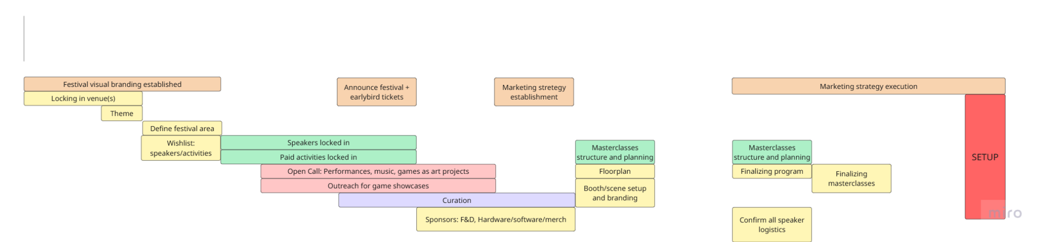
TIMELINE

Slide 13
PARTNERSHIPS
Activities & Performances: We would love to hear from you if you would like to create, show or participate in our festival.
Food & Drink: We are looking for locally anchored food and drinks partnerships to keep the festival both sustainable and community-focused. With our target audience, we can offer high engagement, social visibility and a revenue sharing model.
Hardware/software: We need the best foundation for showing off games and experiences. By partnering with Game Punch, brands get hands-on exposure and user feedback in a cultural context, as well as the possibility to align the brand with talent development and a new audience.
Merch/fan areas: By inviting both local and international artists, brands and collectives, we create a vibrant and dynamic environment for game and fan art to mesh. Merch partners gain direct sales and brand visibility, and a direct link to creators.

